Slide 1


P195 – Reliance Industries Stock Forecast
Team(Group 3)
Mr. Basharnawaj Khan
Ms. Shweta parkhe
Mr. Shiwam Sahu
Mr. Prashant Wakchaure
Mr. Sahil Hemanth
Mr. Vaibhav Devanand
Mentor Name – Neha Ramachandran
Date: 27-02-2023

Slide 2
Business Objective:
Predict the Reliance Industries Stock Price for the next 30 days.
There are Open, High, Low and Close prices that you need to obtain from the web for day starting from 2015 to 2022 for Reliance Industries stock.

Slide 3
Project Architecture / Project Flow:
1. Importing Libraries
2. Importing Dataset
3. EDA
4. Visualization
5. Model Building
6. Model Evaluation
7.Deployment

Slide 4
Exploratory Data Analysis

Slide 5
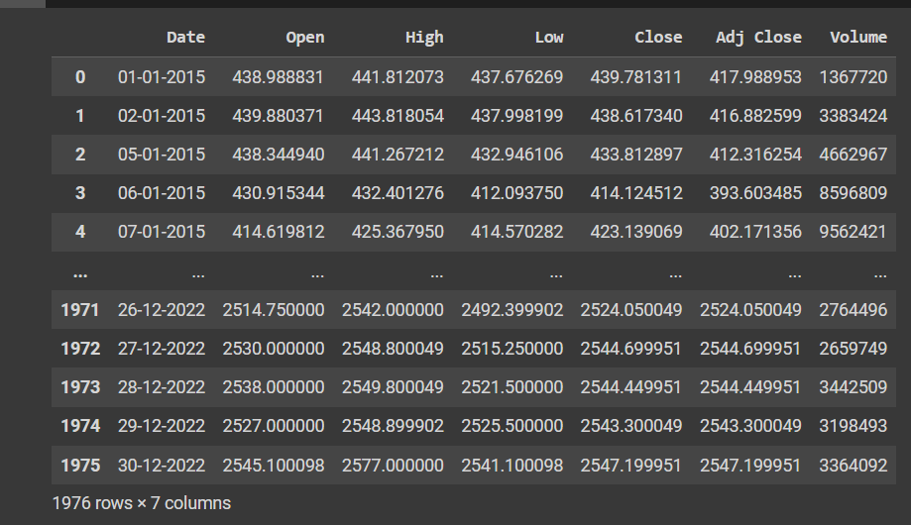
Data set details:
The dataset used is Reliance Industries stock market data from NSE (National Stock Exchange) India over the last 7 years (2015 - 2022)
The dataset contains 1976 samples. Each sample contains 7 features.
Date - Date of trade
Open - The open is the starting period of trading on a securities exchange or organized over-the-counter
Market
High - Highest price at which a stock traded during the course of the trading day.
Low - Lowest price at which a stock traded during the course of the trading day.
Close - (Target variable) The close is a reference to the end of a trading session in the financial market
when the market close for the day
Adj.close - The price of the stock after paying off the dividends.
Volume - It is the amount of a security that was traded during a given period of time

Slide 6
Exploratory Data Analysis (EDA):
The data contains a total of 7 features for 1976 days.
The given data does not contain any 'nan' values hence we don't have any missing values, also the data types are correct.
For all the columns the mean value is greater than the median value (50% percentile) so we can say that the dataset is positively skewed in nature.
The given dataset does not contain any duplicate rows

Slide 7
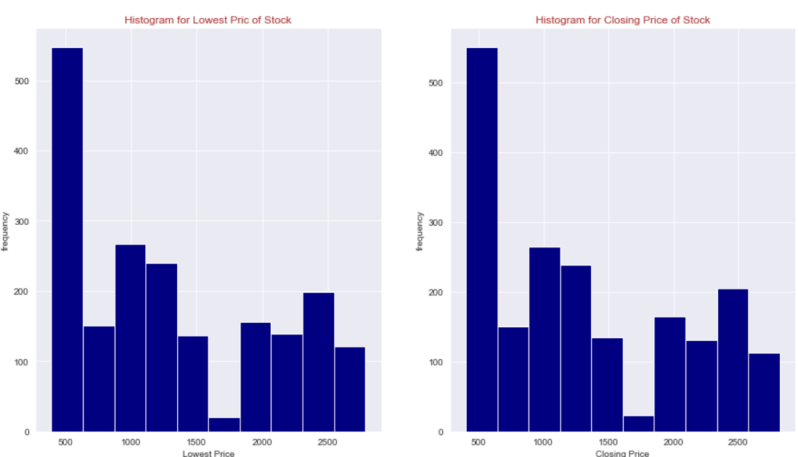
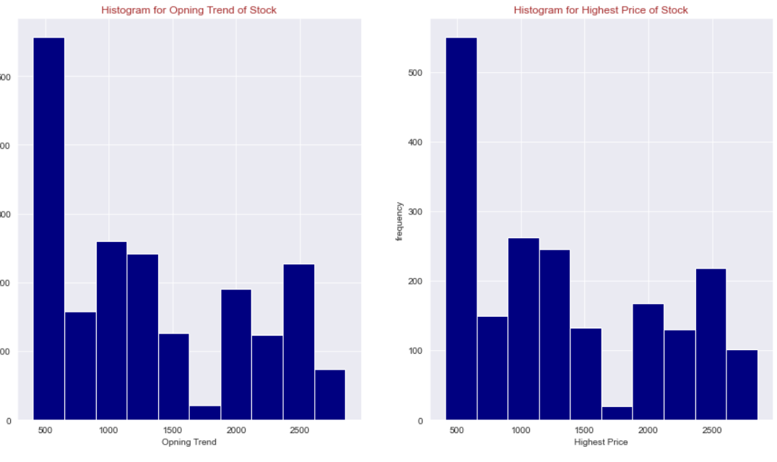
Histogram for Open, High, Low, Close:
By analyzing the above histograms we can say that the given dataset is not symmetric in nature

Slide 8
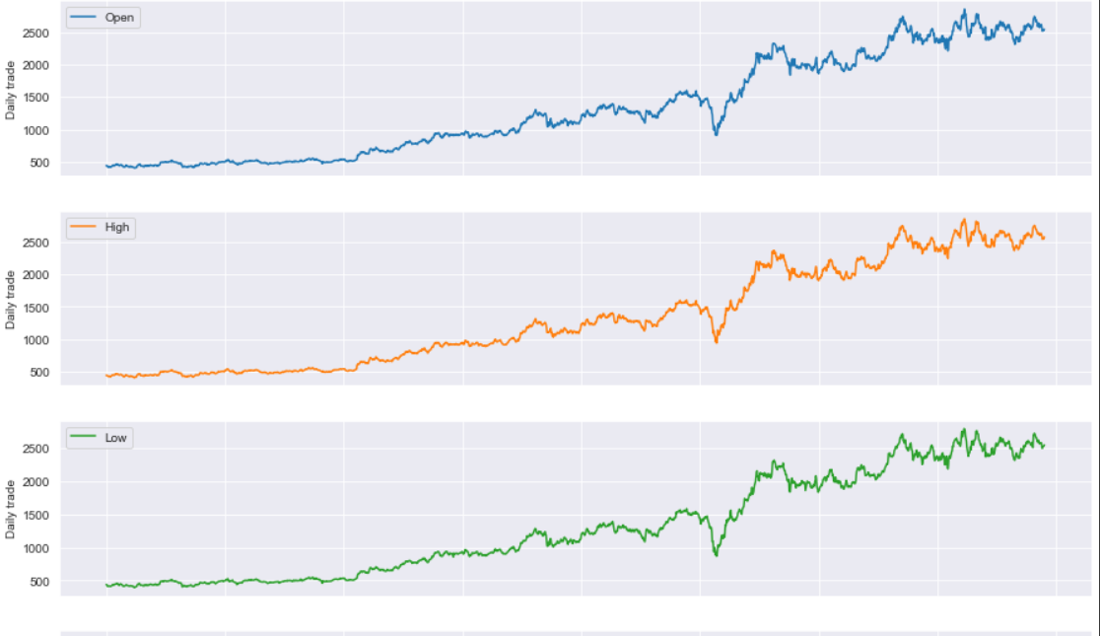
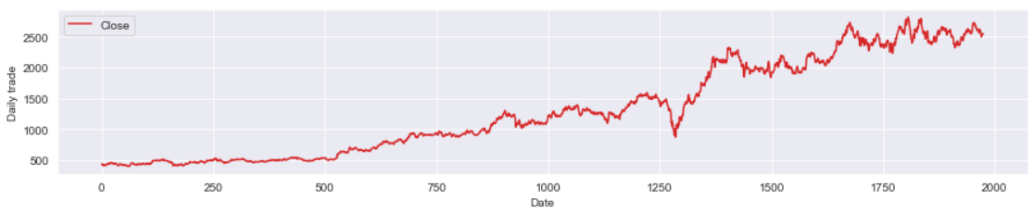
Open, High, Low, Close Over the Time:
After analyzing all the above graphs we can say that all the trend follows the same pattern over the last 7 years.

Slide 9
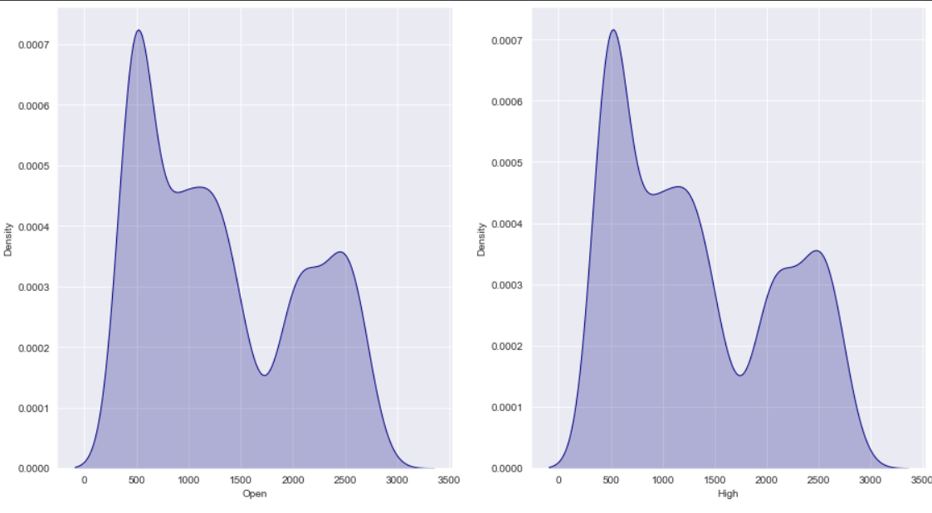
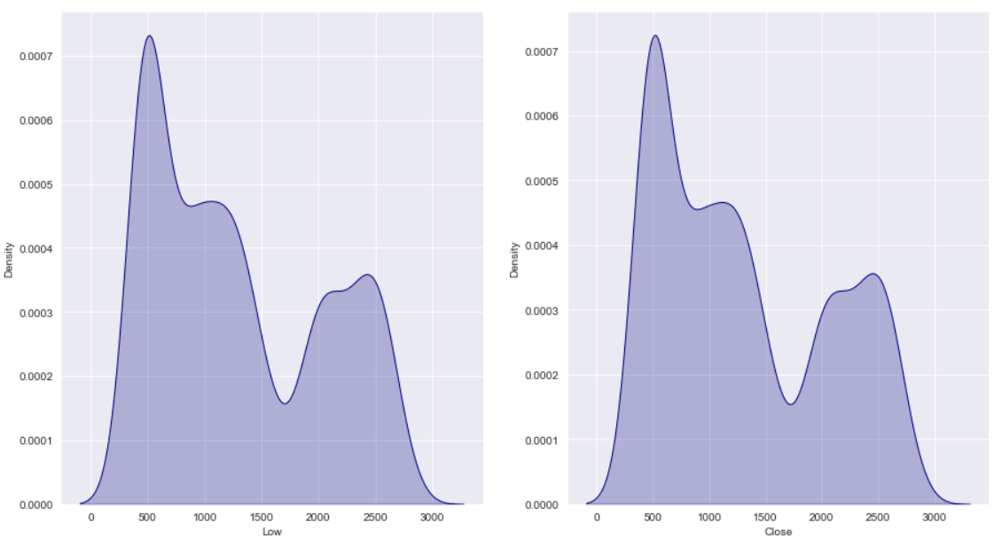
Kernel Distribution Estimation Plot(KDE):
For all the features density curve is right skewed and all the trend follows the same pattern.

Slide 10
Model Building:
By using train and test split model validation techniques we have builded following 2 machine learning models.
Auto Regressive Model
Holts Winter Model

Slide 11
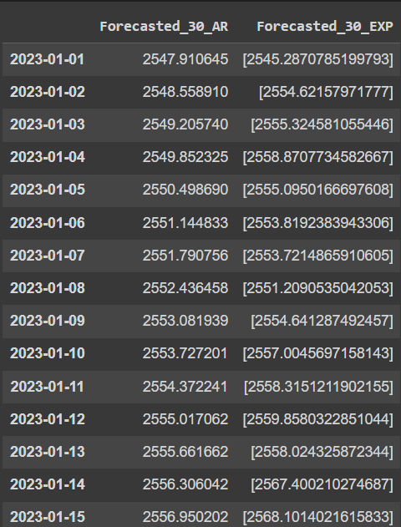

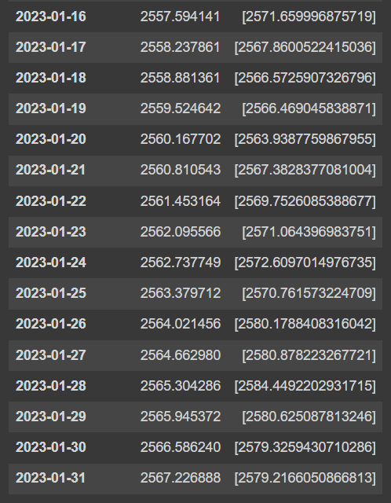
Forecast for next 30 days:

Slide 12
Template for Model results presentation:
Data set details:
Models used:
Reliance Industries Stock Price
Auto Regressive Model
Holts Winter Model
Data Partition details:
Evaluation metric
Input variable: date
Target variable: close
First 1728 days are taken as training data and remaining 248 as testing data
Mean absolute percentage error:
AR model: 3.8
Simple exponential: 6.27
Holt method: 12.57
Holts winter exponential smoothing with additive seasonality & additive trend: 4.38
Holts winter exponential smoothing with multiplicative seasonality & additive trend: 3.84

Slide 13
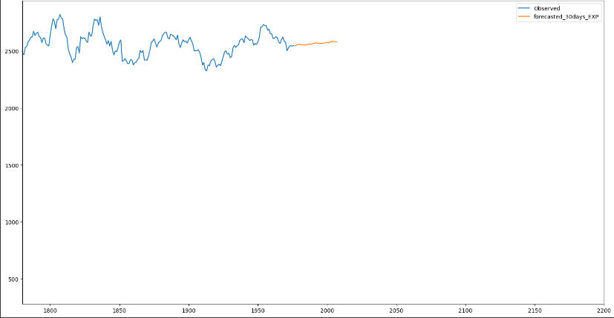
Model Results:
Model generated the output as the predicted stock price for the next 30 days

Slide 14
Model Deployment using R shiny / Flask or any other method:
We have use Streamlit for deployment of your project ‘Reliance Industries Stock Forecast’.
We have also included the EDA part in our deployment codes along with various visualization.

Slide 15
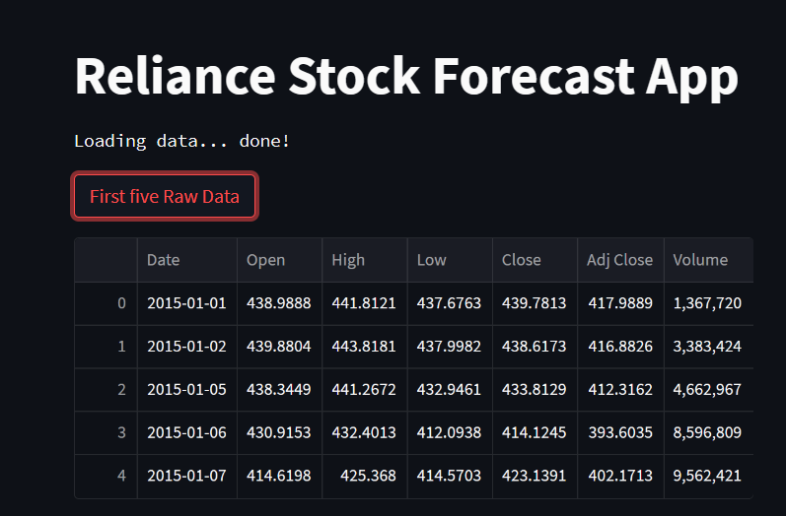

Slide 16
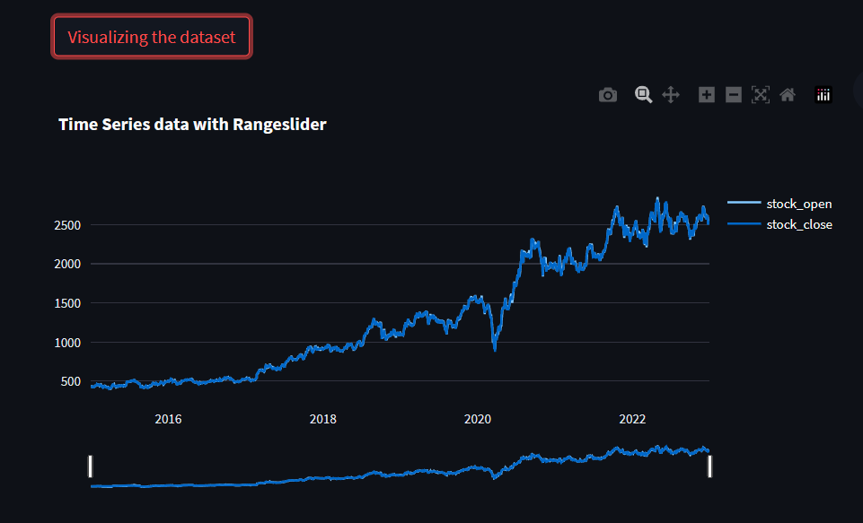

Slide 17
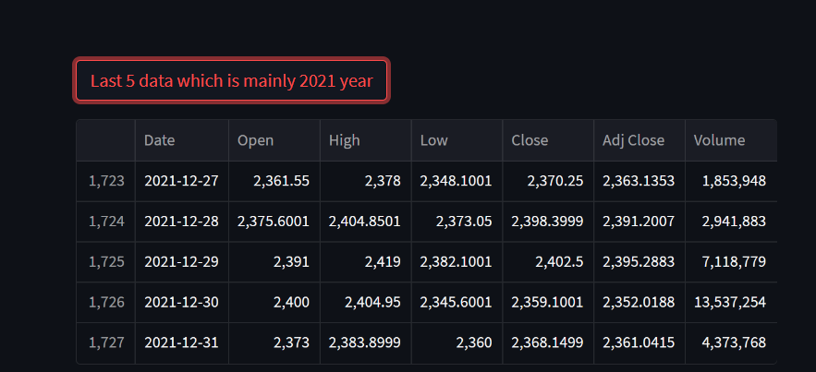

Slide 18
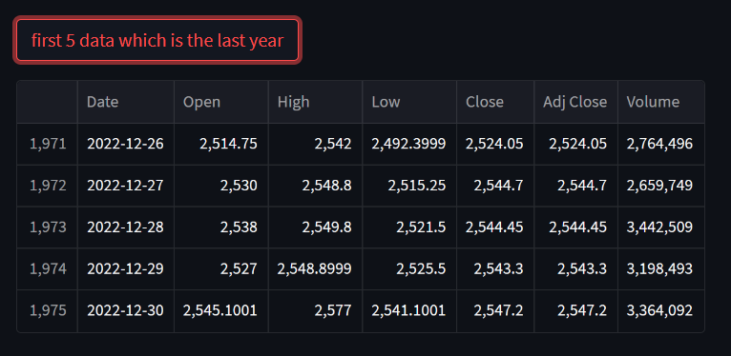

Slide 19
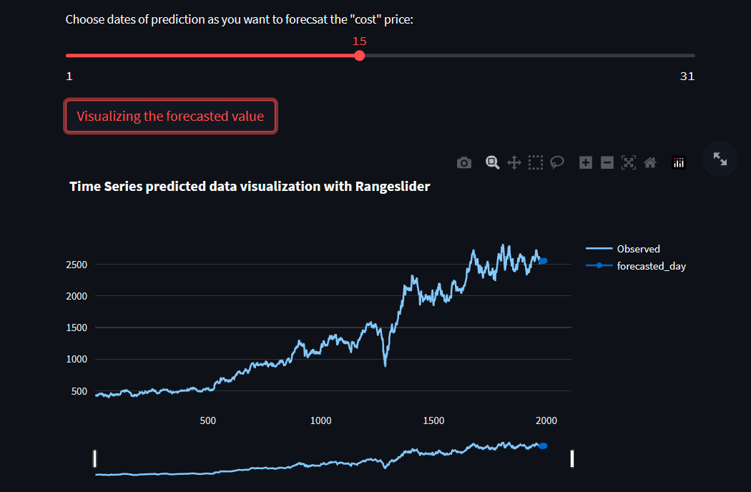

Slide 20
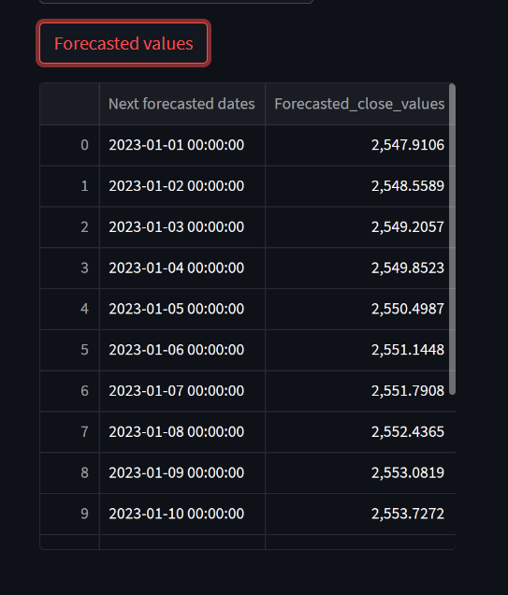

Slide 21
Thank you

